Slide 1
INT577
WEB AND SOCIAL MEDIA ANALYTICS

Slide 2
Course Details
LTP: 004
CA: 2 (online assignments : 2 out of 2)
Text Book:
  SOCIAL MEDIA ANALYTICS: TECHNIQUES AND INSIGHTS FOR EXTRACTING BUSINESS VALUE OUT OF SOCIAL MEDIA by MATTHEW GANIS, AVINASH KOHIRKAR, PEARSON

Slide 3
Topics Include:
Social Media Analytics
Web Analytics
Social media analytics is the practice of gathering data from social media websites and analyzing that data using social media analytics tools to make business decisions. The most common use of social media analytics is to mine customer sentiment to support marketing and customer service activities.
Web analytics is the measurement, collection, analysis and reporting of web data for purposes of understanding and optimizing web usage. Web analytics provides information about the number of visitors to a website and the number of page views.

Slide 4
Cont...
Social media analytics is the practice of gathering data from social media websites or networks such as Facebook, Twitter, Google plus, etc.
Web analytics uses the data collected directly from a particular business website and Social media analytics uses the data collected from social media networks.
  Website analytics is the process of measuring, collecting and analyzing website traffic data to understand user behaviour on your website only, so as to improve the user experience and conversion rate.

Slide 5
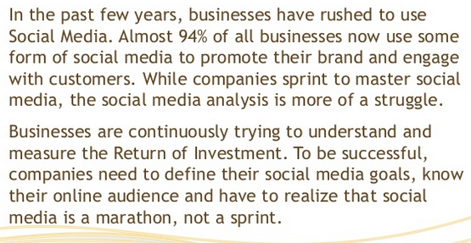
Why Social Analytics is important?

Slide 6
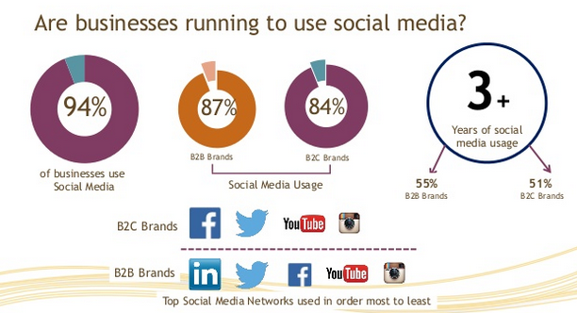

Slide 7
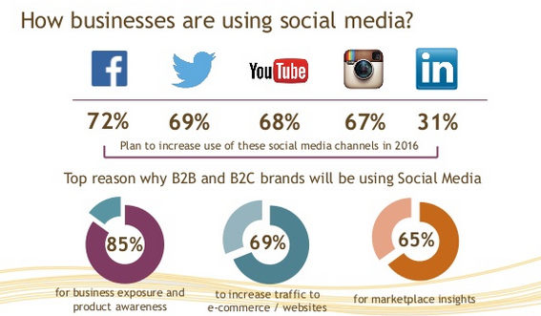
---

Slide 8
Structured and Unstructured Data

Slide 9
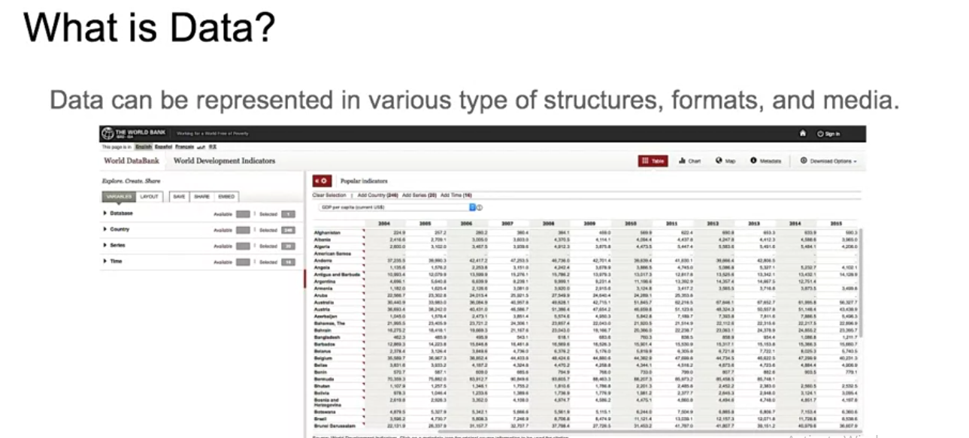

Slide 10
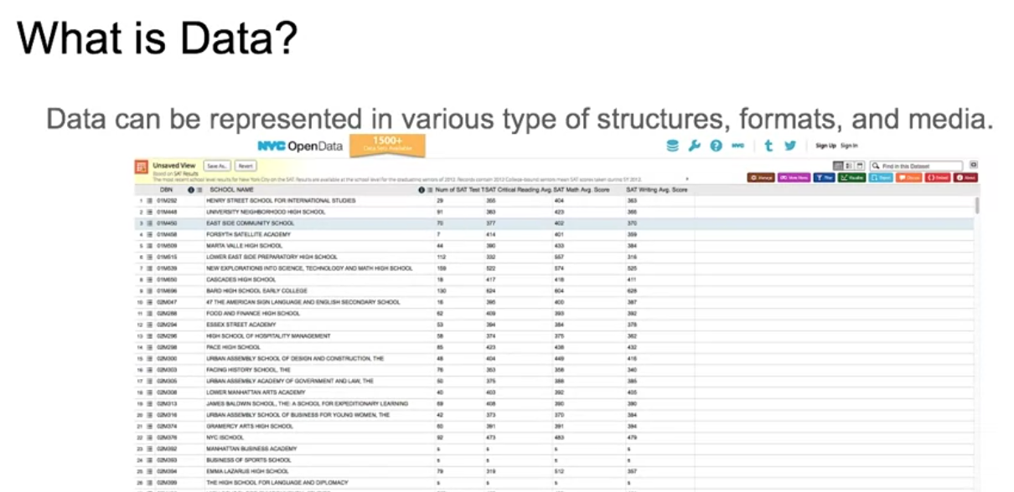

Slide 11
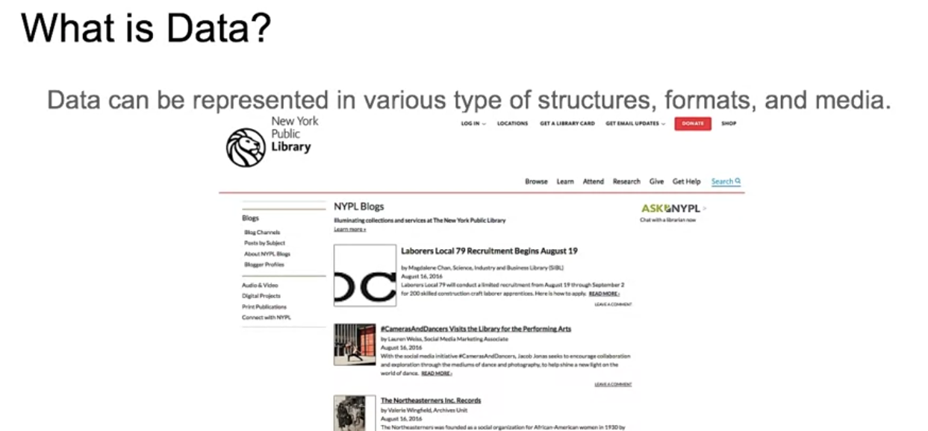

Slide 12
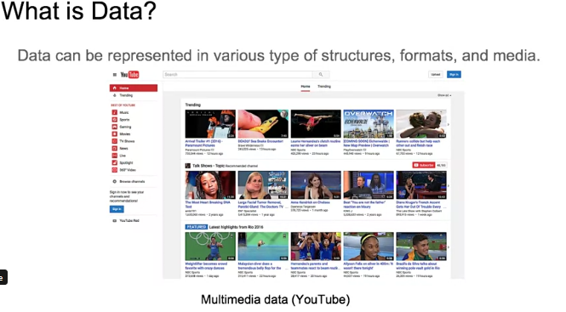

Slide 13
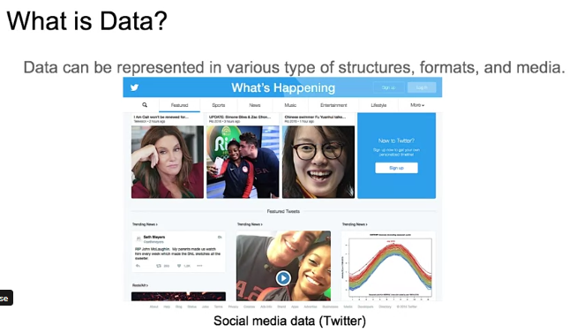

Slide 14
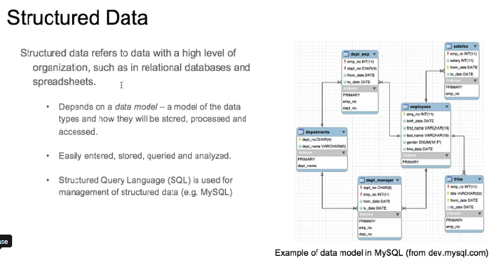

Slide 15
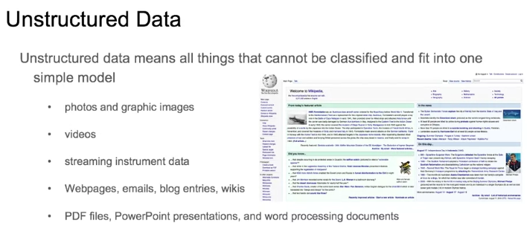

Slide 16
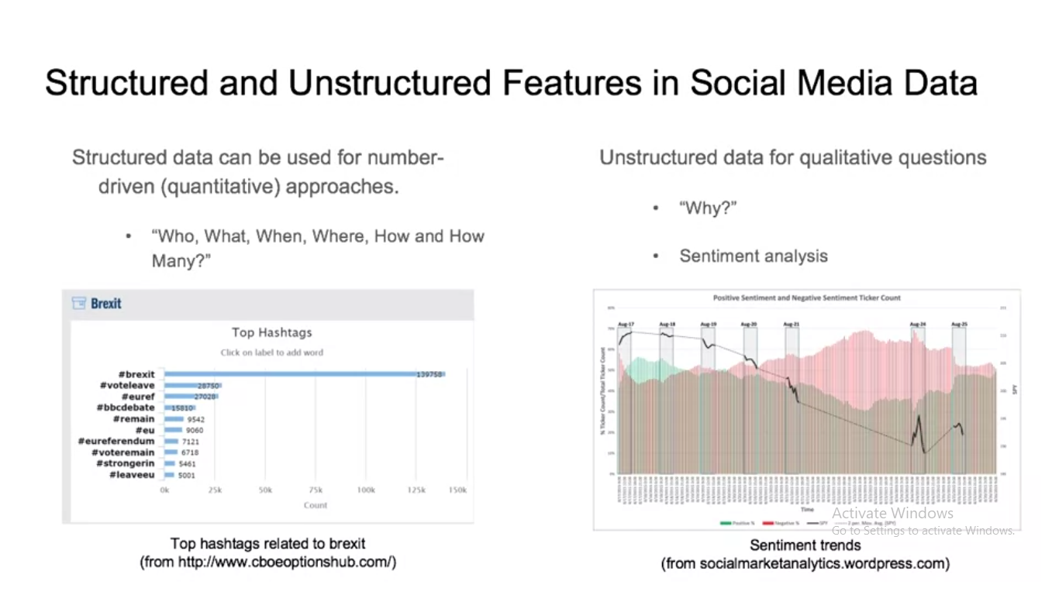

Slide 17
